Slide 1
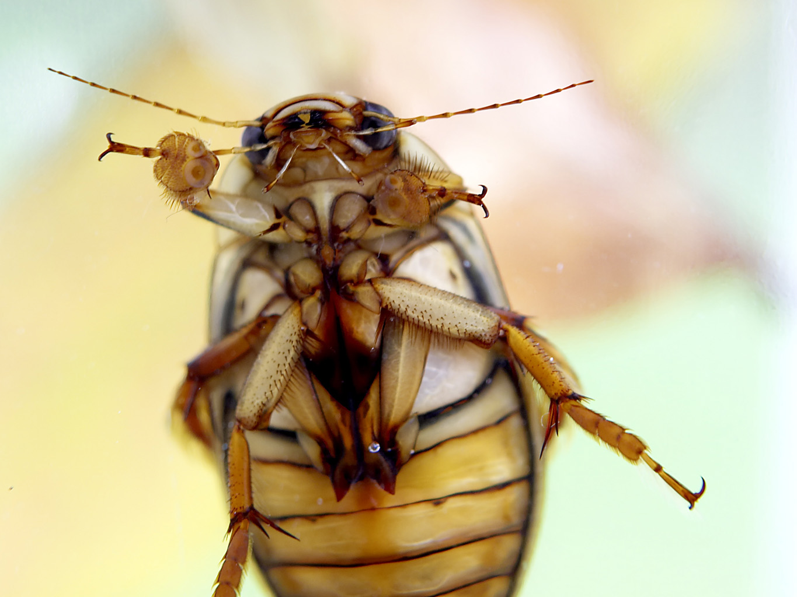


Slide 2
STATISTICAL TESTS FOR CONNECTION ALGORITHMS FOR STRUCTURED NEURAL NETWORKS
Daniel Hjertholm

Slide 3
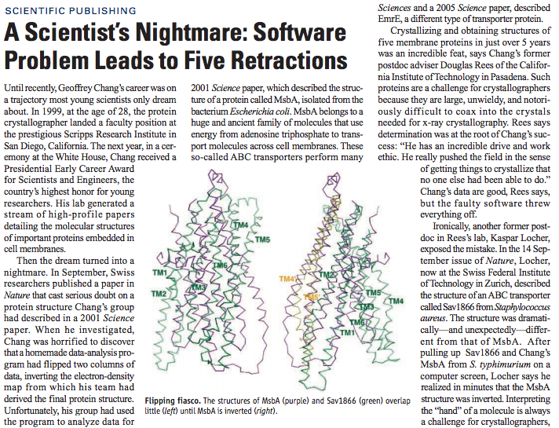
MOTIVATION
Science 314, 1856 (2006)

Slide 4
STATISTICAL TESTING
Solution: Test!
Statistical testing
False positives
False negatives
Adaptable test strategy
Two classes of networks:
Random convergent / divergent networks
Spatially structured networks

Slide 5
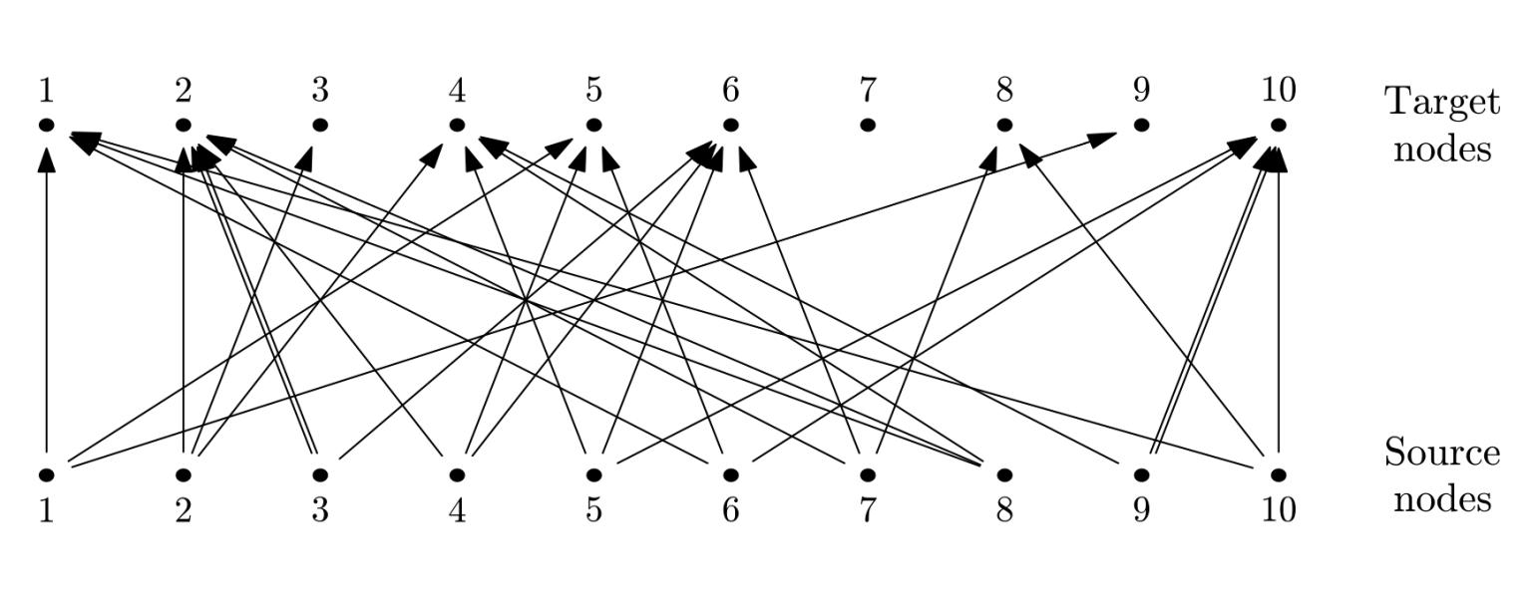
RANDOM {CON/DI}VERGENT CONNECTIONS
import nest
N_s = 10
N_t = 10
C=3
source_neurons = nest.Create(‘iaf_neuron’, N_s)
target_neurons = nest.Create(’iaf_neuron’, N_t)
nest.RandomDivergentConnect(source_neurons,
target_neurons, C)

Slide 6
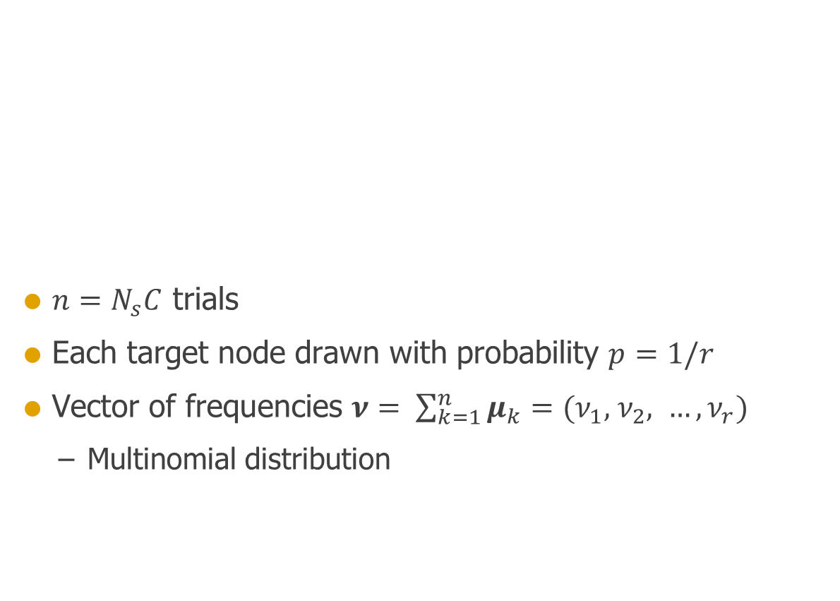
RANDOM {CON/DI}VERGENT CONNECTIONS
$n=N_{s}C$ trials
Each target node drawn with probability $p=1/r$
Vector of frequencies $ν= \sum_{k=1}^{n}{μ_{k}=(ν_{1},{ ν}_{2}, …, ν_{r})}$
Multinomial distribution

Slide 7
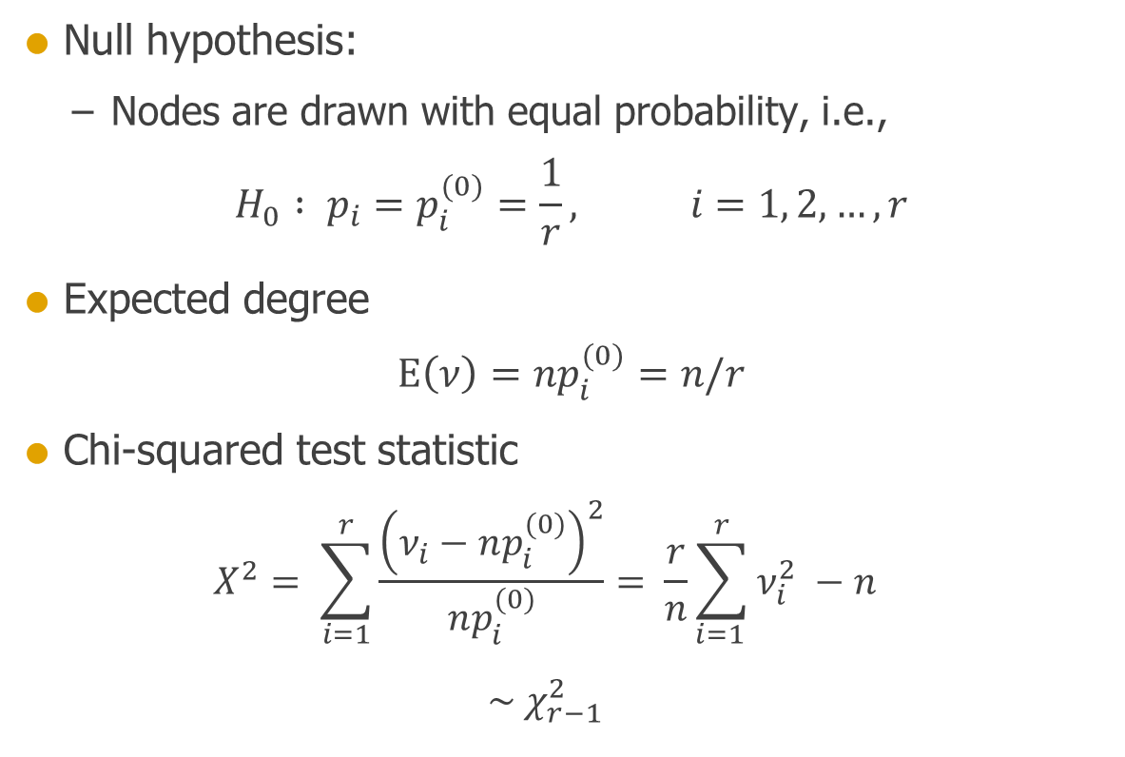
RANDOM {CON/DI}VERGENT CONNECTIONS
Null hypothesis:
Nodes are drawn with equal probability, i.e.,
$$H_{0} : p_{i}=p_{i}^{(0)}=\frac{1}{r}, i=1, 2, …, r$$
Expected degree
$$\text{E}\left(ν\right)=np_{i}^{(0)}=n/r$$
Chi-squared test statistic
$$X^{2}= \sum_{i=1}^{r}{\frac{{\left(ν_{i}−np_{i}^{(0)}\right)}^{2}}{np_{i}^{(0)}}}= \frac{r}{n}\sum_{i=1 }^{r}{ν_{i}^{2}} −n$$
$$\sim χ_{r−1}^{2}$$

Slide 8
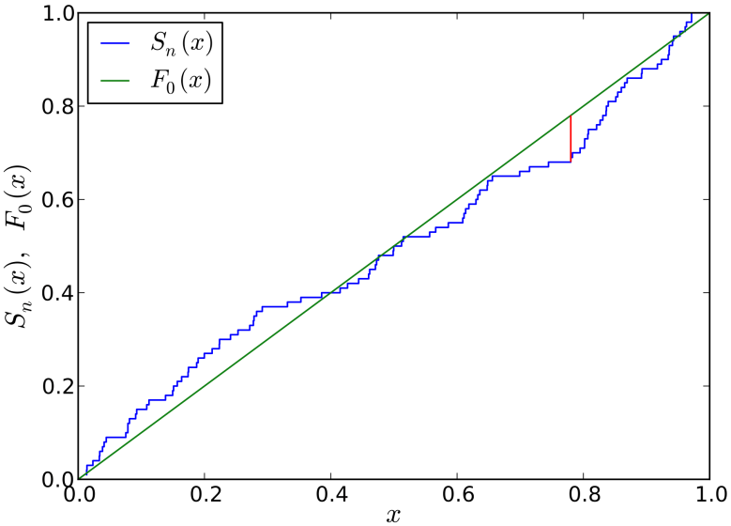
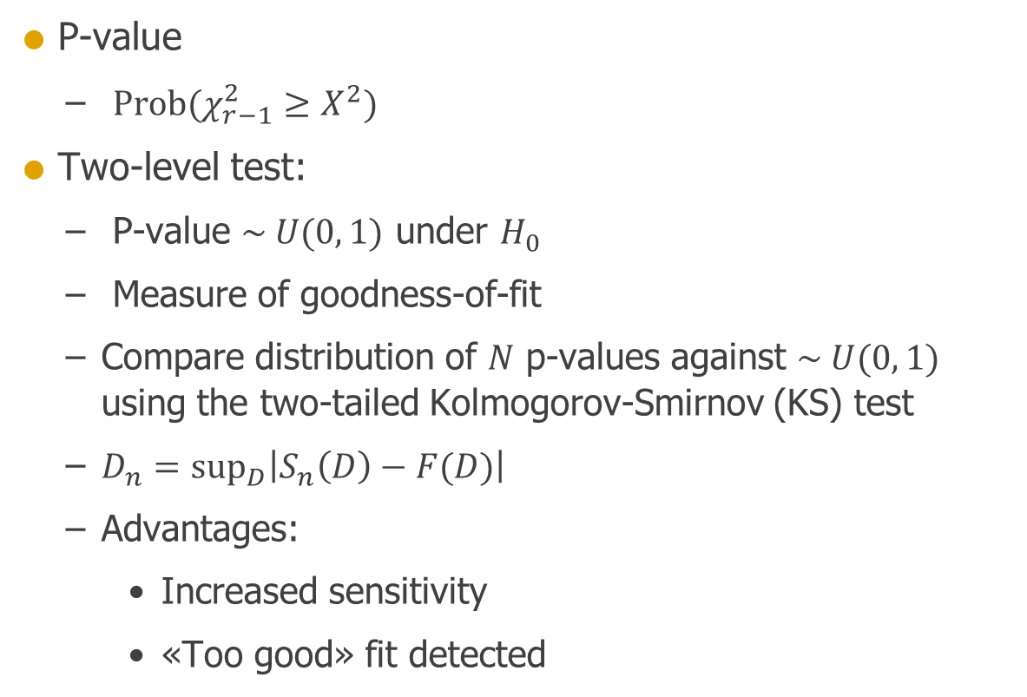
RANDOM {CON/DI}VERGENT CONNECTIONS
P-value
$\text{Prob}(χ_{r−1}^{2}≥X^{2})$
Two-level test:
P-value $\sim U(0, 1)$ under $H_{0}$
Measure of goodness-of-fit
Compare distribution of $N$ p-values against $\sim U(0, 1)$ using the two-tailed Kolmogorov-Smirnov (KS) test
$D_{n}={\text{sup}}_{D}\left|S_{n}\left(D\right)−F(D)\right|$
Advantages:
Increased sensitivity
«Too good» fit detected

Slide 9
IMPLEMENTATION
from test_RDC import *
tester = RDC_tester(N_s=1000, N_t=1000, C=1000)
chi, p = tester.chi_squared_test(msd=0)
print 'Chi-squared test statistic:', chi
print 'p-value of chi-squared test:', p
ks, p = tester.two_level_test(n_runs=1000, start_seed=0,
show_histogram=True,
histogram_bins=100,
show_CDF=True)
print 'KS test statistic:', ks
print 'p-value of KS-test of uniformity:', p

Slide 10
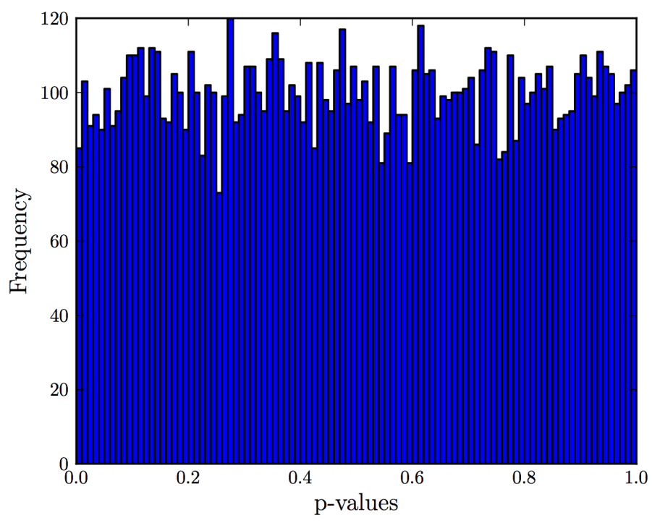
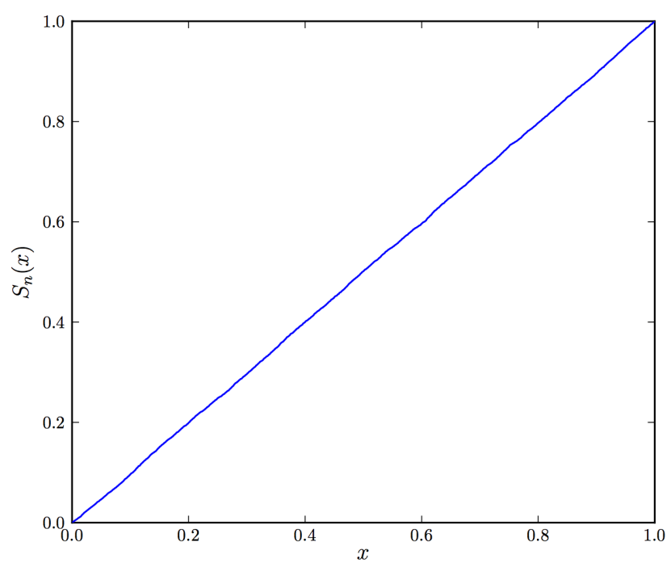
RESULTS
>>> test = RDC_tester(N_s=1000, N_t=1000, C=1000)
>>> ks, p = test.two_level_test(n_runs=10000,
>>> start_seed=0)
>>> print 'p-value of KS-test of uniformity:', p
p-value of KS-test of uniformity: 0.905217259105

Slide 11
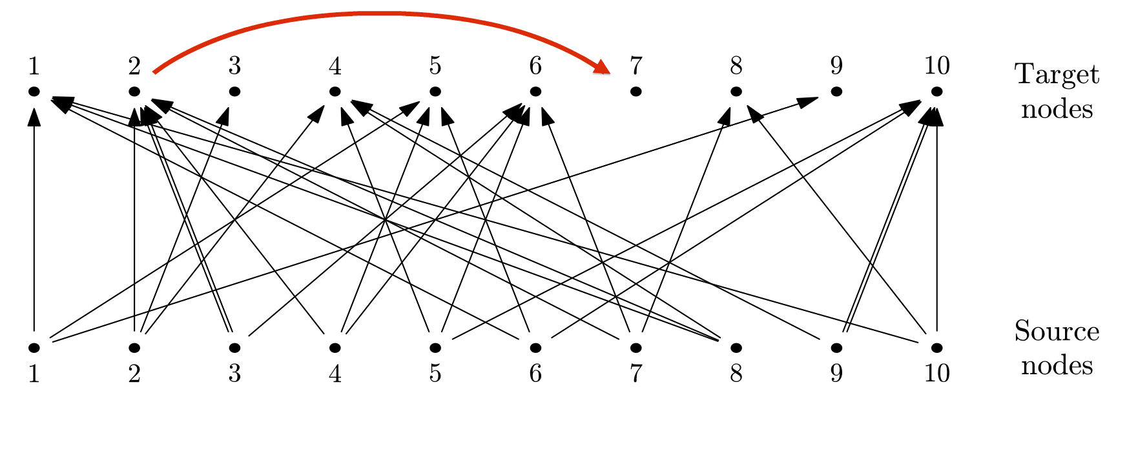
SENSITIVITY
Control algorithm
Example: A ”too good” fit
ks, p = tester.two_level_test(n_runs=1000, start_seed=0,
control=True)

Slide 12
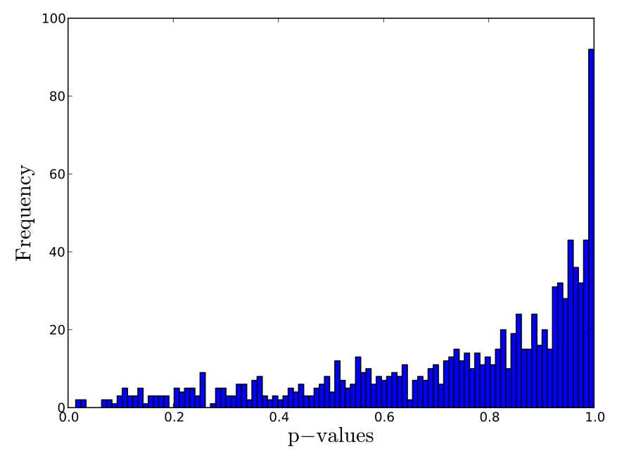
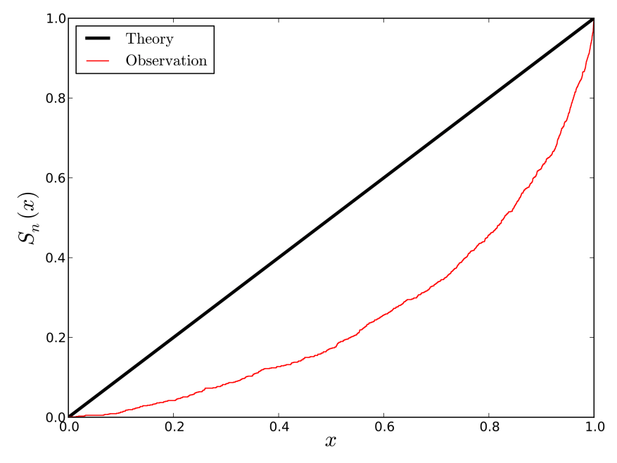
SENSITIVITY
Chi-squared test:
Everything seems fine
Two-level test:
Something is very wrong (p < 10⁻¹³)

Slide 13
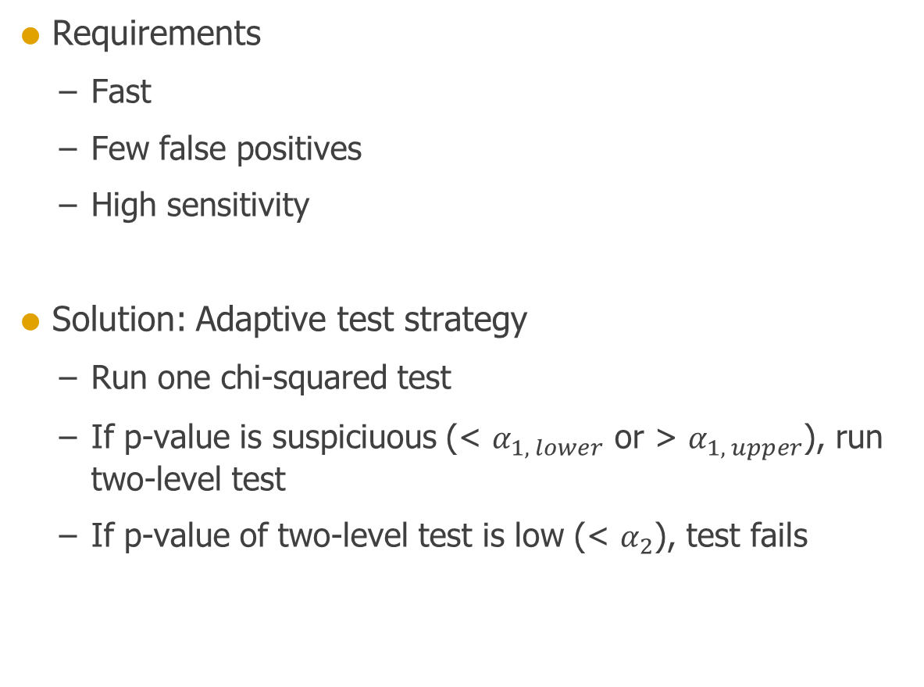
AUTOMATIC TESTING
Requirements
Fast
Few false positives
High sensitivity
Solution: Adaptive test strategy
Run one chi-squared test
If p-value is suspiciuous (< $α_{1, lower}$ or > $α_{1, upper}$), run two-level test
If p-value of two-level test is low (< $α_{2}$), test fails

Slide 14
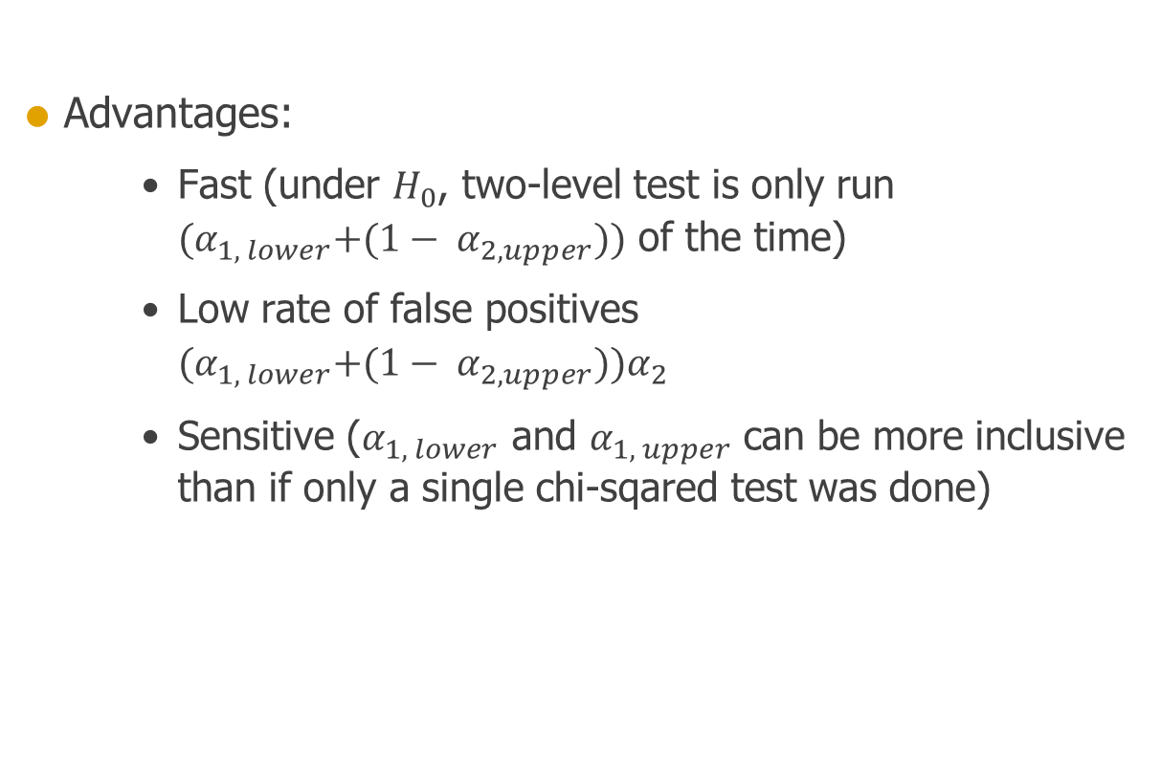
ADAPTIVE TEST STRATEGY
Advantages:
Fast (under $H_{0}$, two-level test is only run ${(α}_{1, lower}+(1− α_{2, upper}))$ of the time)
Low rate of false positives ${(α}_{1, lower}+(1− α_{2, upper}))α_{2}$
Sensitive ($α_{1, lower}$ and $α_{1, upper}$ can be more inclusive than if only a single chi-sqared test was done)

Slide 15
AUTOMATIC TESTING
Implemented using the Python unit testing framework unittest
def test_RCC_large(self):
'''Statistical test of RandomConvergentConnect with a large network'''
test = RCC_tester(N_s=self.N_large, N_t=self.N_large, C=self.C_large)
passed = self.adaptive_test(test, n_runs=self.n_large)
self.assertTrue(passed, 'RandomConvergentConnect did not ' \
'pass the statistical test procedure.')
def test_RDC_threaded(self):
'''Statistical test of RandomDivergentConnect with 4 threads'''
test = RDC_tester(N_s=self.N_medium, N_t=self.N_medium, C=self.C_medium,
threads=4)
passed = self.adaptive_test(test, n_runs=self.n_medium)
self.assertTrue(passed, 'RandomDivergentConnect did not ' \
'pass the statistical test procedure.')

Slide 16
SPATIALLY STRUCTURED NETWORKS
import nest.topology as topo
src_layer = topo.CreateLayer({'elements': 'iaf_neuron',
'positions': [(0., 0.)]})
x = np.random.uniform(-0.5, 0.5, 1000)
y = np.random.uniform(-0.5, 0.5, 1000)
pos = zip(x, y)
tgt_layer = topo.CreateLayer({'elements': 'iaf_neuron',
'positions': pos})
mask = {'rectangular': {'lower_left': [-0.4, -0.4],
'upper_right': [0.4, 0.4]}}
kernel = {'gaussian': {'p_center': 1., 'sigma': 0.2}}
conn_specs = {'connection_type': 'convergent',
'mask': mask, 'kernel': kernel}
topo.ConnectLayers(src_layer, tgt_layer, conn_specs)

Slide 17
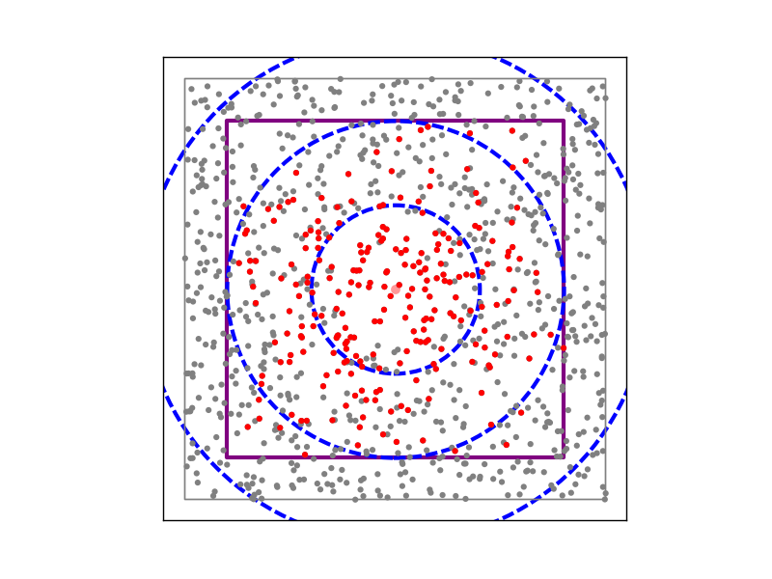
SPATIALLY STRUCTURED NETWORKS

Slide 18
SPATIALLY STRUCTURED NETWORKS
src_layer = topo.CreateLayer({'elements': 'iaf_neuron',
'positions': [(0., 0., 0.)]})
x = np.random.uniform(-0.5, 0.5, 1000)
y = np.random.uniform(-0.5, 0.5, 1000)
z = np.random.uniform(-0.5, 0.5, 1000)
pos = zip(x, y, z)
tgt_layer = topo.CreateLayer({'elements': 'iaf_neuron',
'positions': pos})
mask = {'box': {'lower_left': [-0.4, -0.4., -0.4],
'upper_right': [0.4, 0.4, 0.4]}}
kernel = {'gaussian': {'p_center': 1., 'sigma': 0.2}}
conn_specs = {'connection_type': 'convergent',
'mask': mask, 'kernel': kernel}
topo.ConnectLayers(src_layer, tgt_layer, conn_specs)

Slide 19
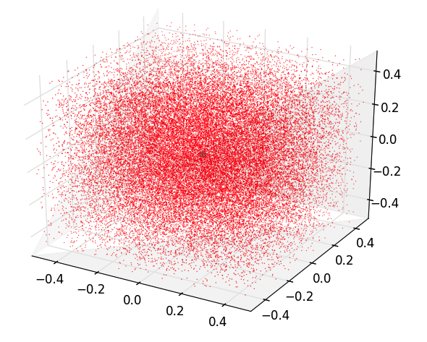
SPATIALLY STRUCTURED NETWORKS

Slide 20
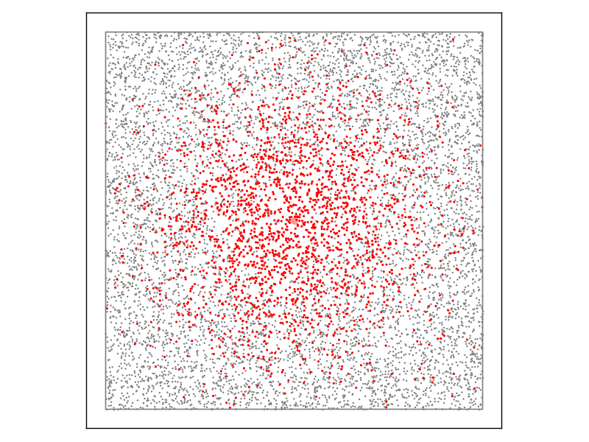
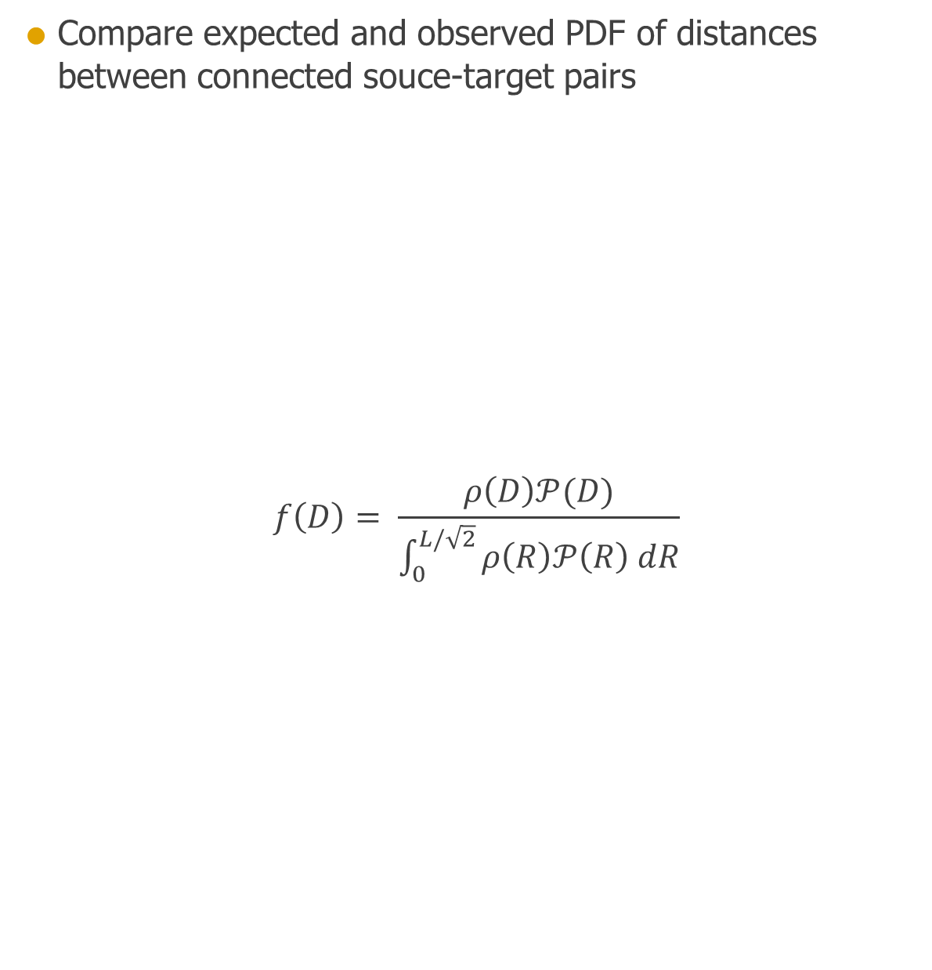
SPATIALLY STRUCTURED NETWORK (2D)
Compare expected and observed PDF of distances between connected souce-target pairs
$$f\left(D\right)= \frac{ρ\left(D\right)𝒫(D)}{\int_{0}^{L/\sqrt{2}}{ρ\left(R\right)𝒫\left(R\right) dR}}$$

Slide 21
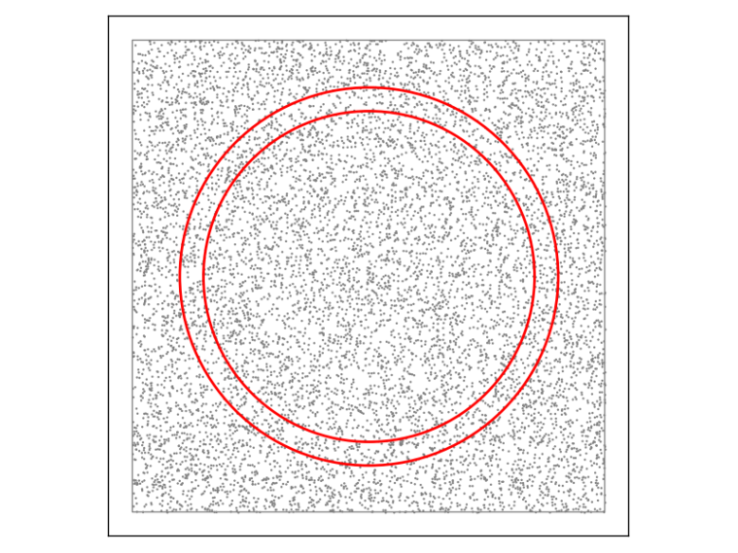
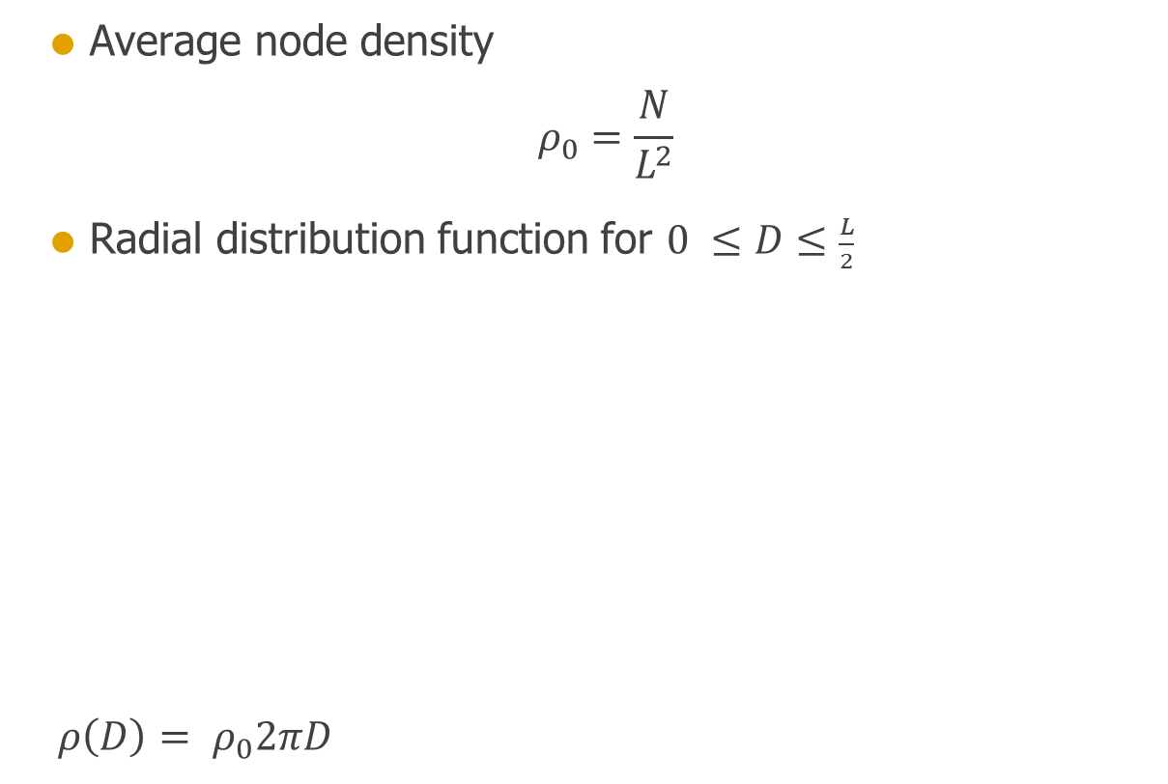
SPATIALLY STRUCTURED NETWORK (2D)
Average node density
$$ρ_{0}=\frac{N}{L^{2}}$$
Radial distribution function for $\text{0 }≤D≤\frac{L}{2}$
$ρ\left(D\right)= ρ_{0}2πD$

Slide 22
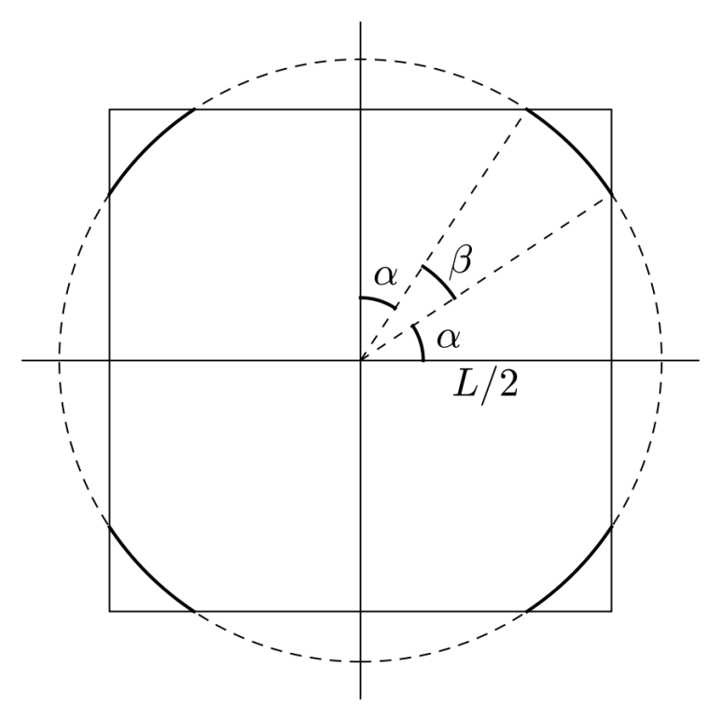
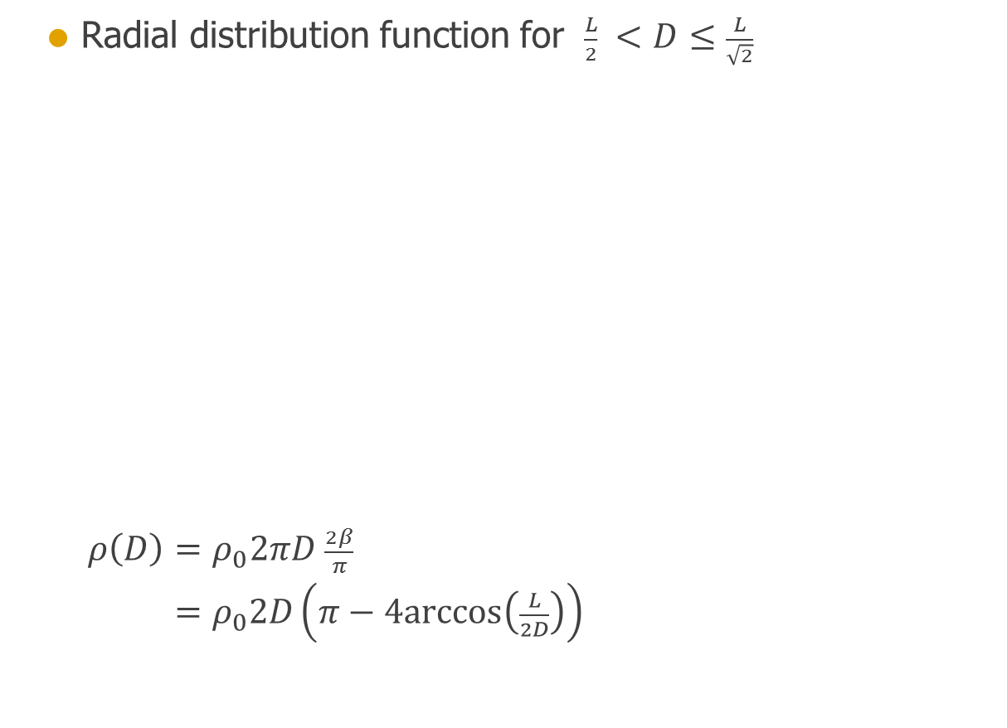
SPATIALLY STRUCTURED NETWORK (2D)
Radial distribution function for $\frac{L}{2} <D≤\frac{L}{\sqrt{2}}$
$ρ\left(D\right)=ρ_{0}2πD \frac{2β}{π}$ $=ρ_{0}2D\left(π−4\text{arccos}\left(\frac{L}{2D}\right)\right)$

Slide 23
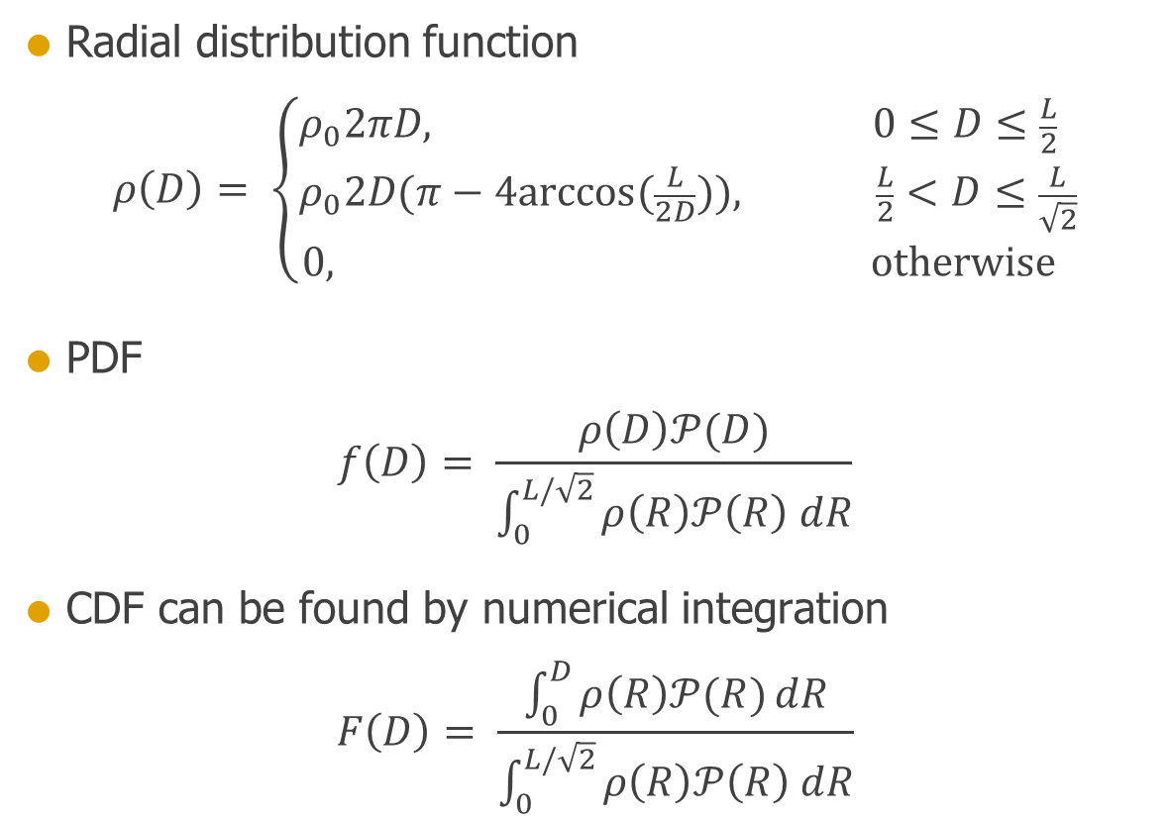
SPATIALLY STRUCTURED NETWORK (2D)
Radial distribution function
$$ρ\left(D\right)= \left\{\begin{aligned}ρ_{0}2πD, 0≤D≤\frac{L}{2} \\ &ρ_{0}2D(π−4\text{arccos}(\frac{L}{2D})), \frac{L}{2}<D≤\frac{L}{\sqrt{2}} \\ 0, \text{otherwise} \end{aligned}\right.$$
PDF
$$f\left(D\right)= \frac{ρ\left(D\right)𝒫(D)}{\int_{0}^{L/\sqrt{2}}{ρ\left(R\right)𝒫\left(R\right) dR}}$$
CDF can be found by numerical integration
$$F\left(D\right)= \frac{\int_{0}^{D}{ρ\left(R\right)𝒫(R)}dR}{\int_{0}^{L/\sqrt{2}}{ρ\left(R\right)𝒫\left(R\right) dR}}$$

Slide 24
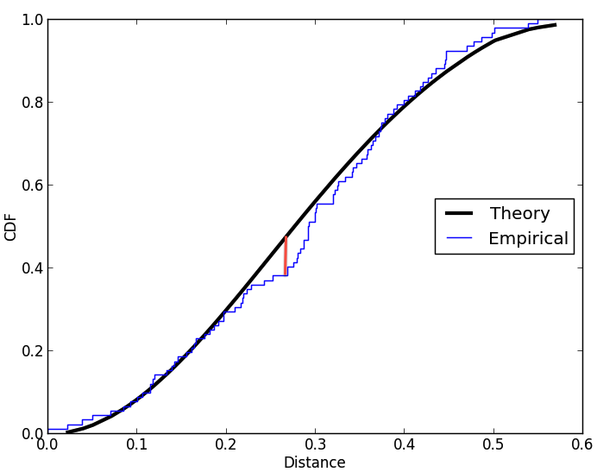
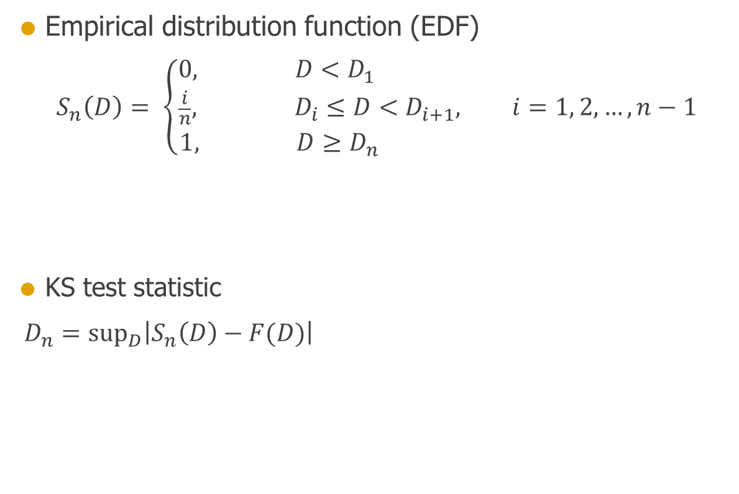
SPATIALLY STRUCTURED NETWORK (2D)
Empirical distribution function (EDF)
$$S_{n}\left(D\right)= \left\{\begin{aligned}0, D<D_{1} \\ &\frac{i}{n}, D_{i}≤D<D_{i+1}, i=1, 2, …, n−1 \\ 1, D≥D_{n} \end{aligned}\right.$$
KS test statistic
$D_{n}={\text{sup}}_{D}\left|S_{n}\left(D\right)−F(D)\right|$

Slide 25

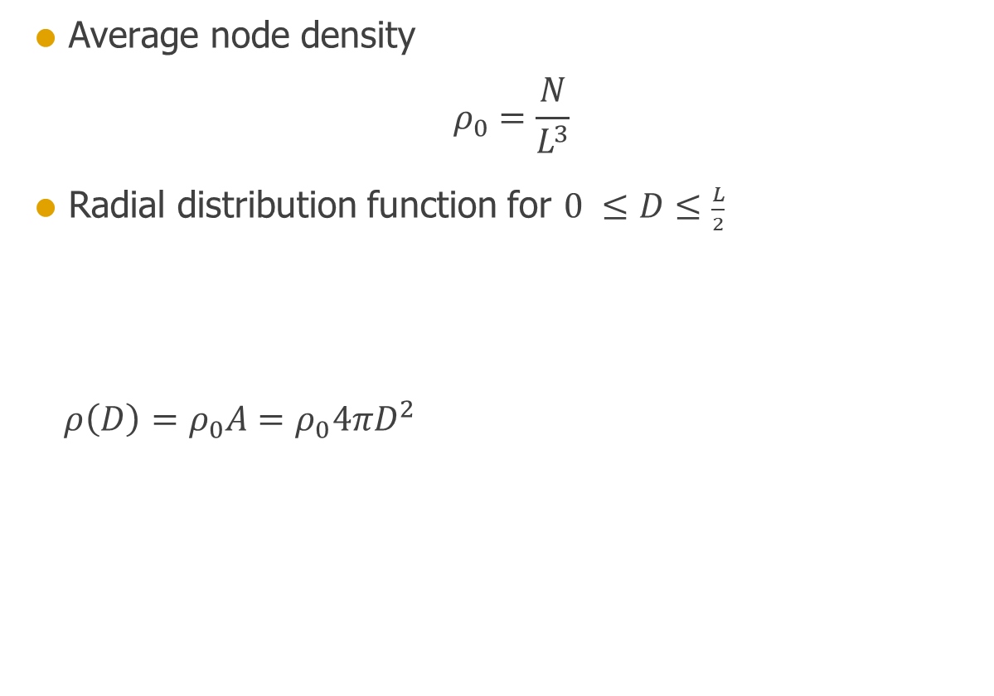
SPATIALLY STRUCTURED NETWORK (3D)
Average node density
$$ρ_{0}=\frac{N}{L^{3}}$$
Radial distribution function for $\text{0 }≤D≤\frac{L}{2}$
$ρ\left(D\right)=ρ_{0}A=ρ_{0}4πD^{2}$

Slide 26

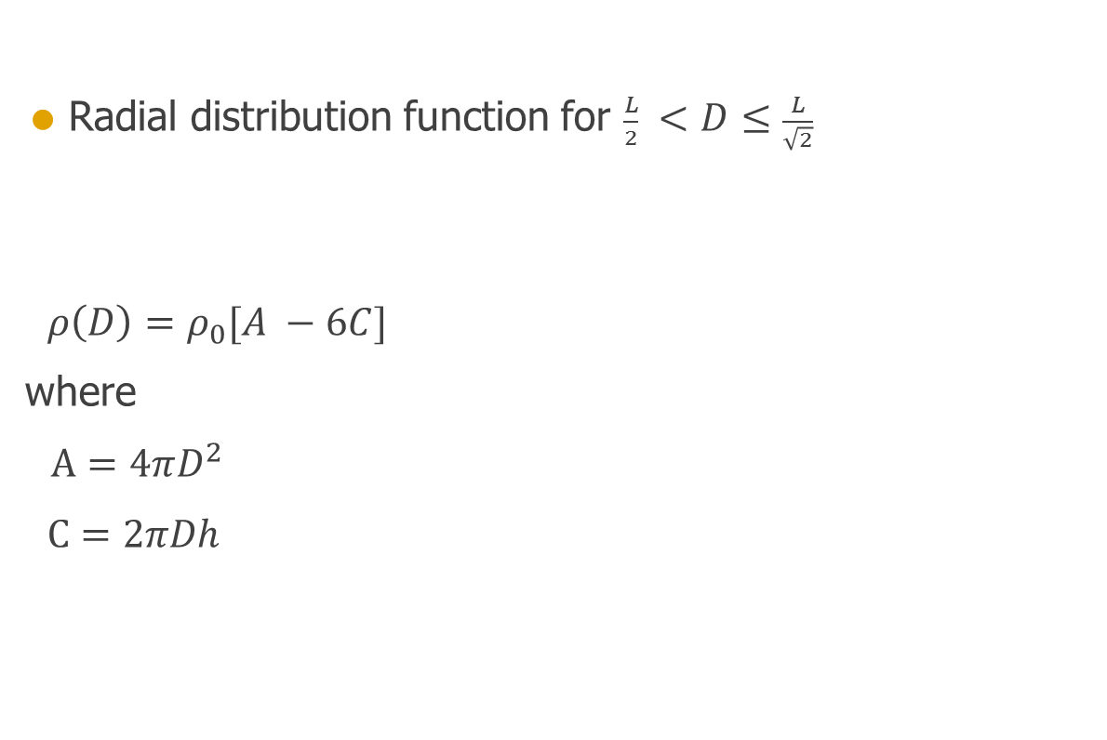
SPATIALLY STRUCTURED NETWORK (3D)
Radial distribution function for $\frac{L}{2} <D≤\frac{L}{\sqrt{2}}$
$ρ\left(D\right)=ρ_{0}[A −6C]$
where
$A=4πD^{2}$
$C=2πDh$

Slide 27
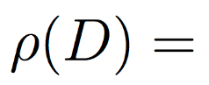
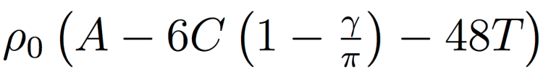
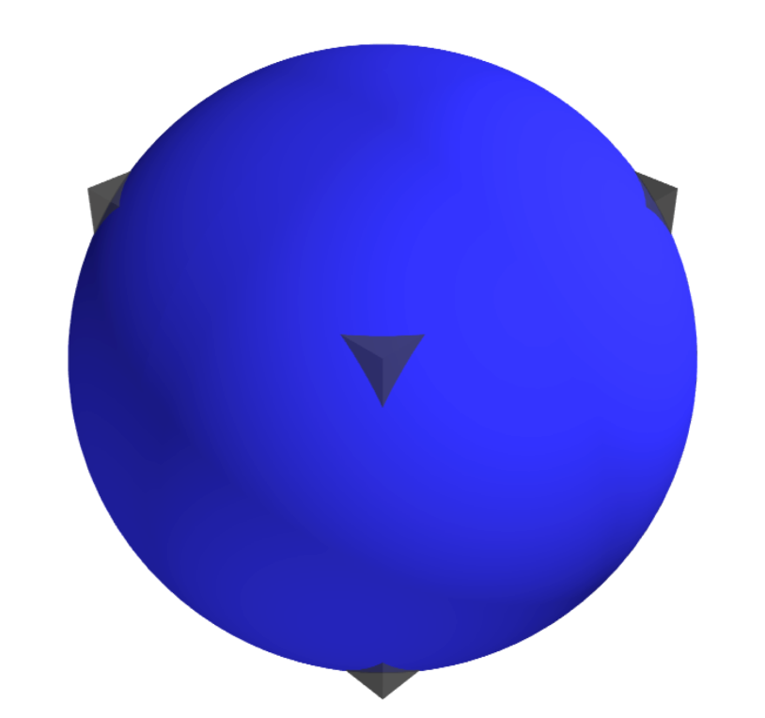
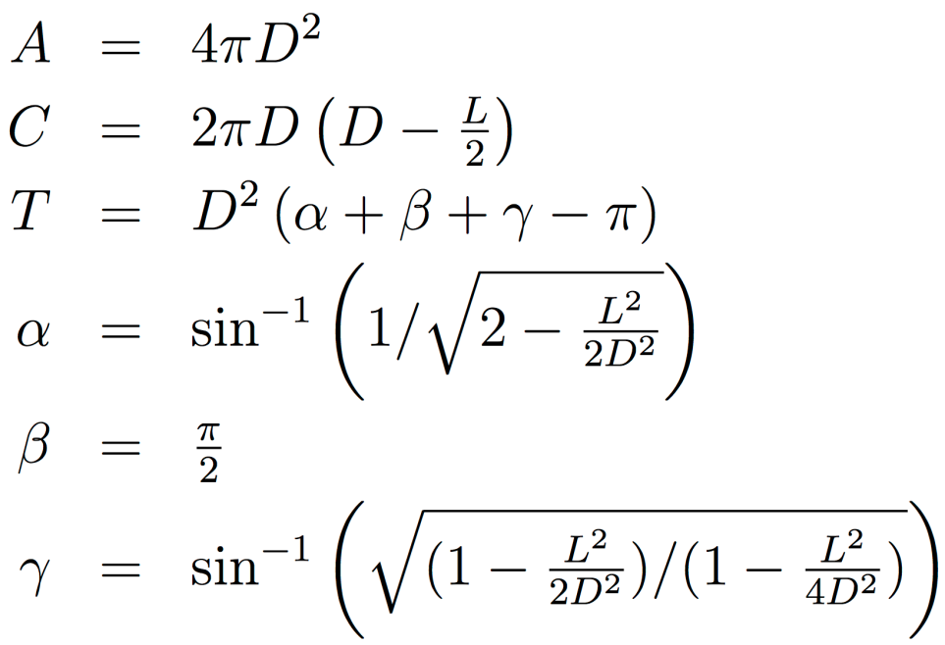
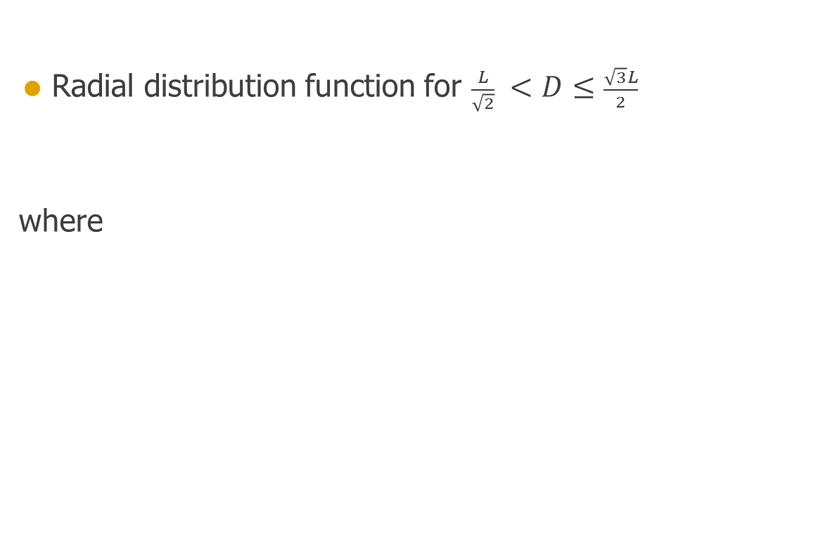
SPATIALLY STRUCTURED NETWORK (3D)
Radial distribution function for $\frac{L}{\sqrt{2}} <D≤\frac{\sqrt{3}L}{2}$
where

Slide 28
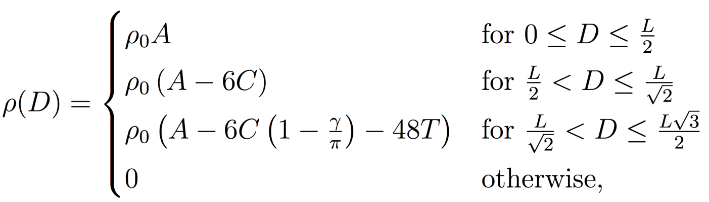
SPATIALLY STRUCTURED NETWORK (3D)
Radial distribution function

Slide 29
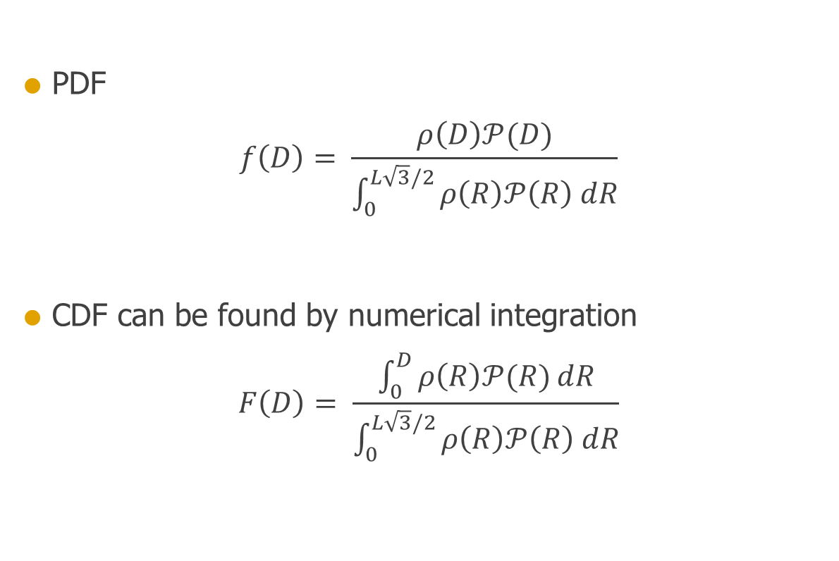
SPATIALLY STRUCTURED NETWORK (3D)
PDF
$$f\left(D\right)= \frac{ρ\left(D\right)𝒫(D)}{\int_{0}^{L\sqrt{3}/2}{ρ\left(R\right)𝒫\left(R\right) dR}}$$
CDF can be found by numerical integration
$$F\left(D\right)= \frac{\int_{0}^{D}{ρ\left(R\right)𝒫(R)}dR}{\int_{0}^{L\sqrt{3}/2}{ρ\left(R\right)𝒫\left(R\right) dR}}$$

Slide 30
SPATIALLY STRUCTURED NETWORK (3D)
Empirical distribution function (EDF)
$$S_{n}\left(D\right)= \left\{\begin{aligned}0, D<D_{1} \\ &\frac{i}{n}, D_{i}≤D<D_{i+1}, i=1, 2, …, n−1 \\ 1, D≥D_{n} \end{aligned}\right.$$
KS test statistic
$D_{n}={\text{sup}}_{D}\left|S_{n}\left(D\right)−F(D)\right|$

Slide 31
IMPLEMENTATION
from test_3D import *
tester = ConnectLayers3D_tester(L=1.0, N=10**6,
function_name='gaussian',
function_params={'p_center': 1., 'sigma': .25,
'mean': 0., 'c': 0.}},
source_pos=(0.3, 0.3, 0.3),
msd=0)
ks, p = tester.ks_test(show_network=True, show_PDF=True, show_CDF=True)
print 'KS test statistic:', ks
print 'p-value of KS-test of uniformity:', p

Slide 32
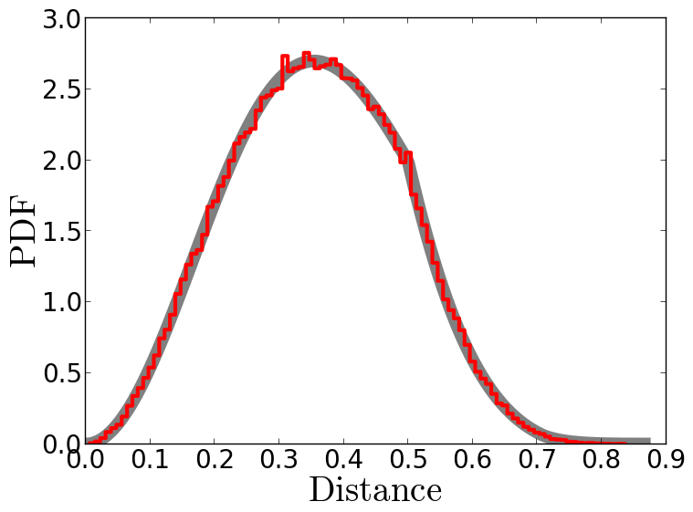
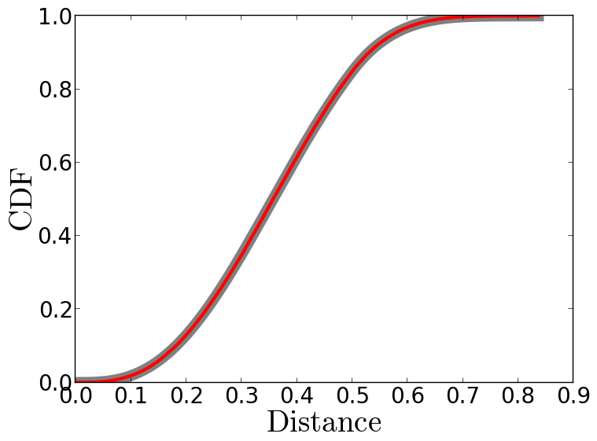

RESULTS
>>> test = ConnectLayers_tester(L=1.0, N=1000000, msd=0
>>> function_name='gaussian')
>>> ks, p = test.ks_test(show_network=False, show_PDF=True,
>>> show_CDF=True)
>>> print 'KS test statistic:', ks
>>> print 'p-value of KS-test:', p
p-value of KS-test: 0.789718501116

Slide 33
CONTROL ALGORITHM
from test_3D import *
test = ConnectLayers_tester(L=1.0, N=10**6,
function_name='gaussian', msd=0)
ks, p = test.ks_test(control=True)
print 'KS test statistic:', ks
print 'p-value of KS-test of uniformity:', p

Slide 34
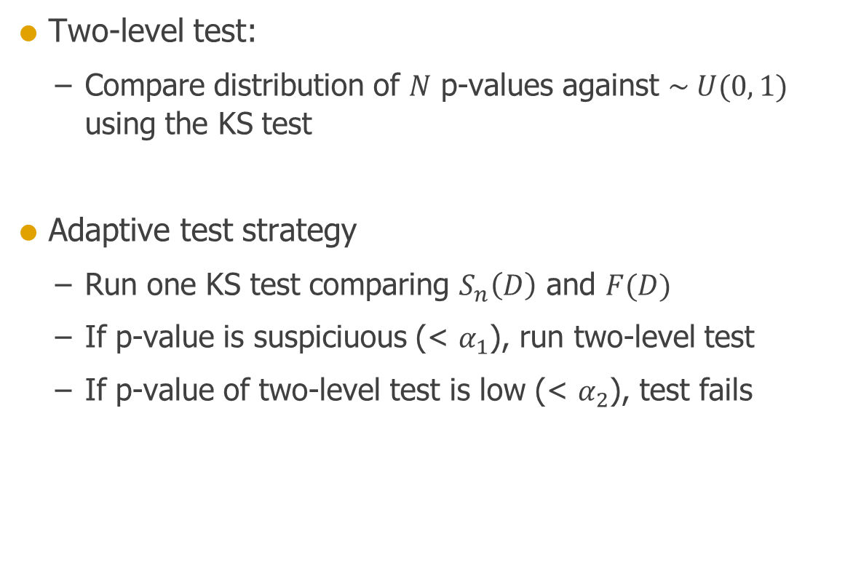
AUTOMATIC TESTING
Two-level test:
Compare distribution of $N$ p-values against $\sim U(0, 1)$ using the KS test
Adaptive test strategy
Run one KS test comparing $S_{n}\left(D\right)$ and $F(D)$
If p-value is suspiciuous (< $α_{1}$), run two-level test
If p-value of two-level test is low (< $α_{2}$), test fails

Slide 35
AUTOMATIC TESTING
Implemented using the Python unit testing framework unittest
def test_2D_exponential(self):
'''KS test performed on source-target node distances'''
self.assertTrue(self.ks_test(ConnectLayers2D_tester, 'exponential'),
'ConnectLayers did not pass the KS test.')
def test_2D_gaussian(self):
'''KS test performed on source-target node distances'''
self.assertTrue(self.ks_test(ConnectLayers2D_tester, 'gaussian'),
'ConnectLayers did not pass the KS test.')
def test_3D_exponential(self):
'''KS test performed on source-target node distances'''
self.assertTrue(self.ks_test(ConnectLayers3D_tester, 'exponential'),
'ConnectLayers did not pass the KS test.')

Slide 36
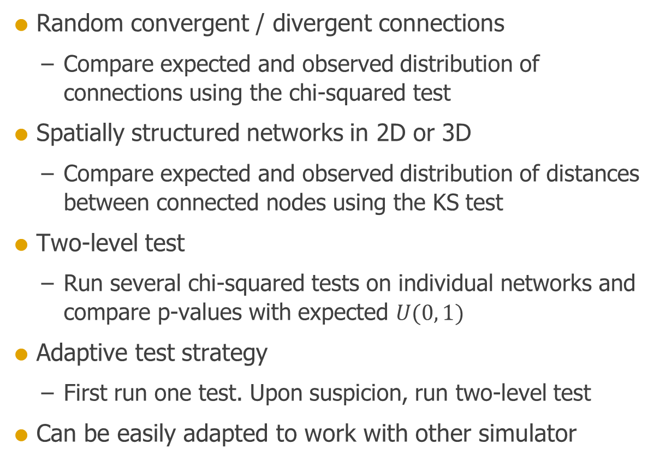
SUMMARY
Random convergent / divergent connections
Compare expected and observed distribution of connections using the chi-squared test
Spatially structured networks in 2D or 3D
Compare expected and observed distribution of distances between connected nodes using the KS test
Two-level test
Run several chi-squared tests on individual networks and compare p-values with expected $U(0, 1)$
Adaptive test strategy
First run one test. Upon suspicion, run two-level test
Can be easily adapted to work with other simulator

